Slide 1
Chapter 5. Data Representation

Slide 2
Aims
  At the end of the section we are going to:
  review binary, octal and hexadecimal systems and their relationships
  know the basic arithmetic operations in the binary system
  know the different forms of representation of the information in the computer.

Slide 3
Index
Introduction
Basic arithmetic operations
Integer number representation
    Sign and Magnitude
    Complement to two
    Excess to Z
Real number representation
    Fixed point
    Floating point. Format IEEE 754
Character representation

Slide 4
Bibliography
Main
  Introducción a los Computadores. J. Sahuquillo y otros. Ed. SP-UPV, 1997 (ref. 97.491).
    Bloques I, II, III y IV
Recommended
  Organización y Diseño de Computadores:
  La Interficie Circuitería/Programación.
  D.A. Patterson y J.L. Hennessy. Ed. Reverté.
    Bloques III y IV
  Digital Design: Principles and Practices. J.F. Wakerly. Ed. Prentice Hall.
    Bloque II
Other
  Computer Organization. V.C. Hamacher y otros. Ed. McGraw-Hill.
  Organización de Computadoras: Un Enfoque Estructurado.
  A.S. Tanenbaum. Ed. Prentice Hall.
  Sistemas Digitales. A. Lloris y otros. Ed. McGraw-Hill.

Slide 5
Índice
Introduction
Basic arithmetic operations
Integer number representation
    Sign and Magnitude
    Complement to two
    Excess to Z
Real number representation
    Fixed point
    Floating point. Format IEEE 754
Character representation

Slide 6
Introduction
External representation
  Used by people: decimal system, alphanumeric characters, etc.
External representation
  Used by computer: binary system, ASCII code, etc.

Slide 7
Introduction
Previously we have seen data representation using:
  Binary
  Octal
  Hexadecimal
  Decimal
We studied the equivalences between them and the methods to change from one to another

Slide 8
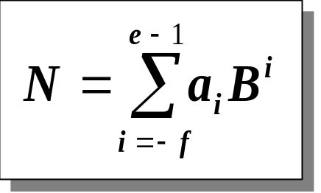
Numbering Systems: Review
Concepts to remember about numbering systems
  Positional numbering systems: base, scale factor
  Binary system: positional System of base 2
Base change: From any base to decimal
  Development of the base power polynomiala_{-f} a_{-f+1} … a₋₁ es la parte fractional (f dígits)
    a₀ a₁ … a_{e-1}
Base change: from decimal to any base B
  Successive divisions between base B for the whole part
  Successive multiplications by base B for the fractional part
  The point separates the integer part and the fractional part

Slide 9
Numbering systems
In addition to the binary system the following numbering systems are used:
  Octal (base 8 = 2³)
    Each octal digit represents a group of exactly 3 bits
    Octal digits: 0, 1, 2, 3, 4, 5, 6, 7
  Hexadecimal (base 16 = 2⁴ )
    Each hexadecimal digit represents a group of exactly 3 bits
    Digits: 0, 1, 2, 3, 4, 5, 6, 7, 8, 9, A (=10₁₀), B (=11₁₀), C (=12₁₀), D (=13₁₀), E (=14₁₀), F (=15₁₀)
its use is extended by
    It is easy to convert from decimal
    Because they allow you to represent long sequences of bits with few digits (Easier to handle than a large sequence of bits)

Slide 10
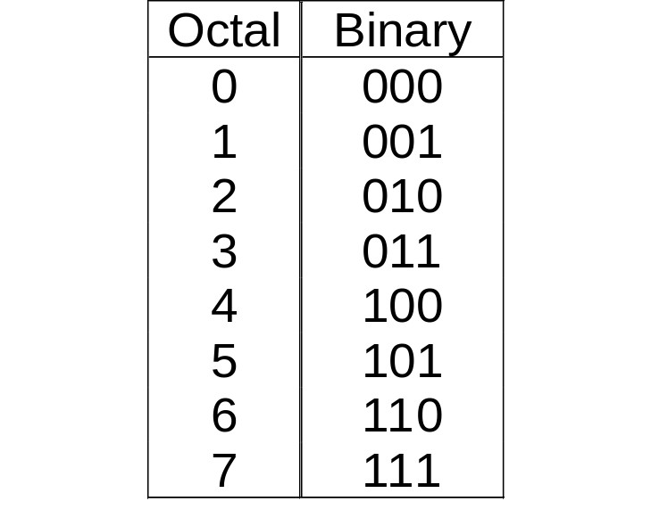
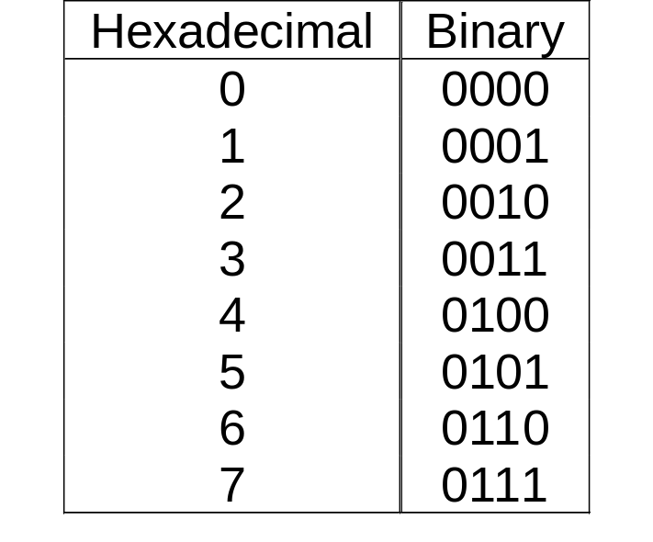
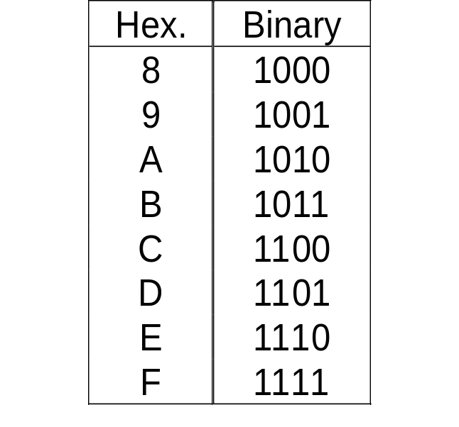
Base change binary, octal, hexadecimal
Considering that the octal and hexadecimal bases are powers of 2 (the binary base), it can be shown that
    In octal (base 2³) a digit represents a group of 3 bits
    In hexadecimal (base 2⁴) a digit represents a group of 4 bits
    In these two cases, the change from one representation to another is done using a table, grouping the bits into blocks of 3 or 4

Slide 11
Base change binary, octal, hexadecimal
Change to/from binary from/to octal and hexadecimal
  When the group is not complet it is stuffed with zeroes
    Zeroes to the left for the integer part.
    Zeroes to the right for the fractional part
  A group of bits never must contain the decimal point
    You must not mix integer bits with fractional bit

Slide 12
Base change: binary, octal, hexadecimal
Example. Given N = F9,E3B₁₆
  Obtain the decimal representation
  Obtain the binary representation
N = F9,E3B₁₆ =
F₁₆ x 16¹ + 9₁₆ x 16⁰ + E₁₆ x 16⁻¹ + 3₁₆ x 16⁻² + B₁₆ x 16⁻³ =
= 15₁₀ x 16¹ + 9₁₀ x 16⁰ + 14₁₀ x 16⁻¹ + 3₁₀ x 16⁻² + 11₁₀ x 16⁻³
= 249,8894042969₁₀
N = F9,E3B₁₆ =
1111 1001 , 1110 0011 1011₂

Slide 13
Base change: binary, octal, hexadecimal
Change from octal to binary and to hexadecimal
  15,36₈ =
  15,36₈ =
  001 101 , 011 110 ₂
  001 101 , 011 110 ₂ =
  (grouping by 4 bits)
  1101 , 0111 1000 ₂ = D,78₁₆

Slide 14
Summary
∑
i
a
8
octal
i
÷
÷
8
8
...,
x
8
x
8
...
1 octal digit = 3 bits
∑
i
a
2
decimal
i
binary
÷
2
÷
2
...,
x
2
x
2
...
1 hexadecimal digit
= 4 bits
∑
i
÷
16
÷
16
...,
a
16
i
hexadecimal
x
16
x
16
...

Slide 15
Índice
Introducción
Operaciones binarias básicas
Representación de números enteros
    Convenio de representación: Signo y Magnitud
    Convenio de representación: Complemento a 2
    Convenio de representación: Exceso Z
Representación de números reales
    Coma fija
    Coma flotante. Formato estándar IEEE 754
Representación de caracteres

Slide 16
Natural numbers representation
Positive natural numbers without sign and without fractional part are denominated natural numbers
Natural numbers are represented by its corresponding binary value
  They will be named “natural binary”
Values
Binary
0 0 0
0 0 1
0 1 0
0 1 1
1 0 0
1 0 1
1 1 0
1 1 1
Natural
0
1
2
3
4
5
6
7

Slide 17
Natural numbers representation
The representation’s range is given by the numbers of bits used to represent natural binary
  With n bits the range of representation is: [0, 2^{n} - 1]
  The number of different values represented is 2^{n}
It is possible to overflow the representation range when we make arithmetic operations with natural numbers
  Overflow means that the result cannot be represented using n bits

Slide 18
Natural numbers basic arithmetic operations
The rules applied to natural binary numbers to obtain basic arithmetical operations (add, sub, mult, and div) are very close to the rules used when operating with decimal values. The difference is the base.
When adding two natural binary numbers using n bits:
  Carry is generated when the add of the numbers is greater or equal to the base ( >= 2 in natural binary, and not >= 10)
When substraction two natural binary numbers using n bits:
  Borrow is calculated as: base + minuend – subtrahend (2 + minuend – subtrahend in binary,
  and not 10 + minuend - subtrahend)

Slide 19
Natural numbers basic arithmetic operations
The add operation can be formalized using a truth table
add of two natural numbers using 2 bits
A B Carry Add
0 0 0 0
0 1 0 1
1 0 0 1
1 1 1 0
0 + 0 = 0
0 + 1 = 1
1 + 0 = 1
1 + 1 = 10 (carry=1)
The corresponding circuit to that truth table is known as “Half Adder” (HA):
S = A ⊕ B, Carry = A·B

Slide 20
Natural numbers basic arithmetic operations
The sub operation can be formalized using a truth table
Sub of two natural numbers using 2 bits
0 - 0 = 0
0 - 1 = 1 (and 1 borrow bit)
1 - 0 = 1
1 - 1 = 0
A B sub borrow
0 0 0 0
0 1 1 1
1 0 1 0
1 1 0 0

Slide 21
Natural numbers basic arithmetic operations
Procedure to add binary represented using n bits:
  The carry bit is added to the MSB neighbor
Carry’s bits
0 1 1 1 1 1 0 1
0 1 1 0 0 1 0 1
0 0 1 1 1 1 0 1
1 0 1 0 0 0 1 0
addends
Result

Slide 22
Natural numbers basic arithmetic operations
Procedure to subtract binary values represented using n bits:
  The borrow bit generated must be substract from the minuend
0 1 0 0 0 1 0 1
0 0 0 1 1 1 0 1
0 0 0 1 1 0 0
0 0 1 0 1 0 0 0
Minuend
Subtrahend
Borrows
Resultado

Slide 23
Overflow on arithmetic operations
Overflow
  The result is not in the range of representation
    Can happen in any representation’s agreement
    The number of bits limitations is the responsible of the overflow
    The overflow indicates that the result is not valid
Overflow’s flag (V o OV)
  Arithmetic circuit’s output used to indicate if an operation’s results is valid or not

Slide 24
Overflow on arithmetic operations
Overflow on natural binary numbers
  It is detected if the MSB carry bit is 1,
    Indicates that it is necessary at least one more bit to represent the result
  Algebraic expression of the Overflow’s flag, V = Cn-1
Example. Binary naturals numbers using 6 bits
44
101100
44
101100
10
001010
24
011000
54
0110110
68
1000100
V=0
V = 1
The results can not be represented using 6 bits

Slide 25
Overflow on natural binary numbers
Example
Exercises
  Add 101110001₂ y 001110110₂
  Sub 101110001₂ y 001110110₂
  Add 101110001₂, 001110110₂ y 011001100₂
44
101100
24
011000
10
001010
44
101100
34
0100010
??
1101100
V=0
V = 1
The results can not be represented using 6 bits

Slide 26
Basic binary operations
Multiplication
  The result of multiply two binary numbers using n and m bits respectively should be represented using n+m bits to avoid overflow
23
1 0 1 1 1
7
0 0 1 1 1
161
1 0 1 1 1
1 0 1 1 1
1 0 1 1 1
0 0 0 0 0
0 0 0 0 0
0 1 0 1 0 0 0 0 1
= 128+32+1 = 161₁₀

Slide 27
Basic binary operations
Multiplication
  Exercises
1 0 0 1 1
1 0 0 0 1
1 0 1 0 1
1 1 1 0 1
1 0 0 1 1
1 0 0 0 1
1 0 0 1 1
1 0 0 0 1
1 0 0 1 1
1 0 0 0 1
1 1 0 0 0 1 1 1 1
1 0 0 0 1
1 1 1 1 0 1 1 0 1

Slide 28
Basic binary operations
Division
  The procedure to divide binary numbers is similar to the procedure to divide decimal numbers.
  The difference is when the quotient’s bit it is not zero it must be one. In decimal division, the quotient’s digit can be a number between 1 and 9

Slide 29
Basic binary operations
Division
  Examples
23
7
1 0 1 1 1
1 1 1
2
3
1 1 1
0
1
= 3₁₀
1 0 1 1 1
1 0 1
1
It does not fit
1 0 1
1
0
0
0 0 0
1 0 1 1
0 0 0 1
1 1 1
1 0 1
0 1 0 0
It does not fit
0 0 0 1 1
1 0 0 1
1 0 1
1 1 1
It does not fit
0 0 1 0
= 2₁₀

Slide 30
Basic binary operations
One’s complement of a X natural number using n bits
  Definition: C2One(X) = 2^{n} - X - 1
  It can be evaluated inverting each bit of the natural number X
Two’s complement of a X natural number using n bits
  Definition: C2Two(X) = 2^{n} – X
  It can be evaluated inverting each bit of the natural number X and adding an extra 1.
  It can be evaluated also as C2Two(X) = C2One(X) + 1

Slide 31
Basic binary operations
Complement operations are comp`lementaruy operations
  C2One( C2One(X) ) = X
    C2One( C2One(X) ) = 2^{n} - ( 2^{n} - X - 1) - 1 = 2^{n} - 2^{n} + X + 1 - 1 = X
  C2Two( C2Two(X) ) = X
    C2Two( C2Two(X) ) = 2^{n} - ( 2^{n} - X) = 2^{n} - 2^{n} + X = X
Exercises:
  C2One(111000101) =
  C2One(000111010) =
  C2Two(111000101) =
  C2Two(000111011) =
000111010
111000101
000111011
111000101

Slide 32
Integers representation
Integer numbers
  Numbers with sign but without fractional part
Representation’s problem
  Computers were designed to store bits on its memory
  When storing a integer number the sign is not stored as “+” or “-”

Slide 33
Integers representation
Solution
  Define agreement’s representation which define the arbitrary rules to store positive and negative values using strings of ones and zeros
Sign extension
  Capacity to extend in a simple way the number of bits used to represent a binary value mantaining the criterion used on the agreement’s representation.
  The phrase “in a simple way” means without aplying complicated arithmetical operations

Slide 34
Integers representation
Criterion 1: Sign and Magnitude
  The MSB is reserved to represent the sign of the binary number
    MSB = 0 for positive numbers
    MSB = 1 for negative numbers
  The rest of bits represents the absolute value of the binary number (expressed as a natural binary but using n-1 bits)
  Symmetrical representation’s range [- (2^{n-1}-1), + 2^{n-1}-1]
  Problem: there are two different string for representing the value zero (One positive and one negative)
  Before adding or subtracting it is necessary to analyze the sign of the operands

Slide 35
Integers representation
Criterion 1: Sign and Magnitude (SM)
  Sign extension is made just adding zeros between the bit sign and the magnitude bits
-3 =>
1 11
+3 =>
0 11
1 011
0 011
1 0011
0 0011
1 00011
0 00011
SM
Decimal
SM
Decimal
0 000…000
+0
1 000…000
-0
0 000…001
+1
1 000…001
-1
0 000…010
+2
1 000…010
-2
0 000…011
+3
1 000…011
-3
…
…
…
…
0 111…110
+(2^{n-1} - 2)
1 111…110
-(2^{n-1} - 2)
0 111…111
+(2^{n-1} - 1)
1 111…111
-(2^{n-1} - 1)

Slide 36
Integers representation
Criterion 2: Two’s Complement (C2Two)
  We do not have to confuse this representation ‘s agreement with the mathematical operation C2Two
  Depending on the sign of the number: there are used two different procedures to represent a number with n bits:
    Positive numbers are represented in sign and magnitude
    Negative numbers are represented by the result of the mathematical operation C2Two (positive value)
  Example: Using 5 bits. Represent +4 y -4
  +4 with 4 bits = 0100 (magnitude) adding sign: 00100_{2c} =+4_{2c}
  -4 = C2Two (+4) = C2Two (00100) = 11100_{2c} = -4_{2c}

Slide 37
Integers representation
Criterion 2: Two’s complement
  The MSB indicates the sign
    MSB=0 for positive numbers
    MSB=1 for negative numbers
  Asymmetrical representation’s range [- 2^{n-1}, + 2^{n-1}-1]
  There is only one representation for zero
C2Two
Decimal
C2Two
Decimal
0000…000
+0
1000…000
-2^{n-1}
0000…001
+1
1000…001
-(2^{n-1} - 1)
0000…010
+2
…
…
0000…011
+3
1111…100
-4
…
…
1111…101
-3
0111…110
+(2^{n-1} - 2)
1111…110
-2
0111…111
+(2^{n-1} - 1)
1111…111
-1

Slide 38
Integers representation
Criterion 2: Two’s complement
  The result of Add and Sub operations do not need changes.
    Therefore it is the criterion more used when operating with integer numbers
-2 =>
110
+2 =>
010
1110
0010
11110
00010
111110
000010

Slide 39
Integers representation
Adding and substracting using Two’s complement
  Given two integer numbers A and B (positive or negatives) represented following the representation’s agreement of Two’s complement
  To evaluate R=A+B and obtain R following the representation’s agreement of Two’s complement, it is necessary to add the operands and ignore the final carry
  To evaluate R=A-B and obtain R following the representation’s agreement of Two’s complement, it is necessry to evaluate the binary sum of A + C2Two(B), The final carry is ignored
  A - B = A + (-B) = A + C2Two(B)

Slide 40
Integers representation
Exercise: Given A=-20 and B=+10. Using 6 bits and following the representation’s agreement of two’s complement: Obtain the result of the following operations:
A+B
A-B
B-A
-20
101100
+10
001010
-10
0 110110
-20
101100
+10
C2Two(001010)
110110
-30
1 100010
+10
001010
-20
C2Two(101100)
010100
+30
0 011110

Slide 41
Overflow on C2Two operations
When operating with numbers represented with the representation’s agreement of C2Two the overflow can:
  Happen when the result can not be represented using n bits. The result is out of the representation’s range.
  Humans beings can detect the overflow just looking the MSB of the result.
    If adding two positive numbers the result is One there is overflow and the result is not valid.
    If adding two negative numbers the result is Zero there is overflow and the result is not valid.
  Computers need a circuit designed to detect the overflow.

Slide 42
Overflow on C2Two operations
A + B =
C_{n-1} C_{n-2} …
A_{n-1} A_{n-2} … A₀
B_{n-1} B_{n-2} … B₀
A_{n-1}
B_{n-1}
C_{n-2}
C_{n-1}
R_{n-1}
C_{n-1}
R_{n-1} R_{n-2} … R₀
0
0
0
0
0
A and B >= 0
0
0
1
0
1
Overflow. if R < 0
0
1
0
0
1
0
1
1
1
0
A>=0 and B<0 or Viceversa
1
0
0
0
1
Overflow is impossible
1
0
1
1
0
1
1
0
1
0
A and B < 0
1
1
1
1
1
Overflow. if R>=0
  V = C_{n-1} ⊕ C_{n-2}

Slide 43
Overflow on C2Two’s operations
  Examples: Using 6 bits obtain the result of the following operations
V=1
V=0
010000
110000
+17
010001
+17
010001
+16
010000
+16
C2Two(010000)
110000
+33
0100001
+01
1000001
R=-31???
R=+1
V=1
V=0
100000
000000
-17
101111
-17
101111
-16
110000
-16
C2Two(110000)
010000
-33
1011111
-01
0111111
R=+31???
R=-1

Slide 44
Integers representation
Criterion 3: Excess to Z
  An arbitrary value denominated excess (z) is chosen to be the zero value.
  Any integer A is represented by the natural binary A+Z.
  Example: Represent +4 y -4 using 6 bits using criterion excess to 31
  +4₁₀ = 31 + 4 = 35 = 100011_{z31}
  -4₁₀ = 31 - 4 = 27 = 011011_{z31}

Slide 45
Integers representation
Criterion 3: Excess to Z
  Asymmetrical range of representation [- Z, + 2^{n} - 1 - Z]
  Each Z’s value defines a different representation’s range
  It is recommended to assign to Z the value 2^{n-1} – 1
  There is only one zero’s representation
Excess to 2^{n-1}-1
Decimal
Excess to 2^{n-1}-1
Decimal
0000…000
-(2^{n-1} - 1)
1000…000
+1
0000…001
-(2^{n-1} - 2)
1000…001
+2
0000…010
-(2^{n-1} - 3)
…
…
0000…011
-(2^{n-1} - 4)
1111…100
+(2^{n-1} - 3)
…
…
1111…101
+(2^{n-1} - 2)
0111…110
-1
1111…110
+(2^{n-1} - 1)
0111…111
0
1111…111
+2^{n-1}

Slide 46
Integers representation
Criterion 3: Excess to Z
  The MSB does not indicates the sign.
  The advantage of this criterion is that the represented values are ordered of minor to greater.
    This allows to compare two numbers with a simple circuit and without conducting operations arithmetical
  It is not possible to make sign’s extension without evaluating mathematical operations
    Normally the value of the excess depends on the amount of available bits

Slide 47
Integers representation
Criterion 3: Excess to Z
  When adding or substracting the result must be adjusted
A
A+Z
A
A+Z
B
B+Z
B
B+Z
A+B
A+B+2Z
A-B
A-B
Z
Z
A+B+Z
(A-B)+Z

Slide 48
Integers representation
Example (using n=6 bits)
Decimal
0
+1
-1
+5
-5
+31
-31
+32
-32
+33
-33
S/M
0 00000
0 00001
1 00001
0 00101
1 00101
0 11111
1 11111
----
----
----
----
[-31,+31]
C2Two
000000
000001
111111
000101
111011
011111
100001
----
100000
----
----
[-32,+31]
Excess to 31
011111
100000
011110
100100
011010
111110
000000
111111
----
----
----
[-31,+32]

Slide 49
Integers representation
Summary
S/M
C2Two
Excess to 2^{n-1}-1
Range
[-(2^{n-1}-1), + 2^{n-1}-1]
[-2^{n-1}, + 2^{n-1}-1]
[-(2^{n-1}-1), + 2^{n-1}]
Sign ext.
Yes (carefully)
Yes
No
Complicated add and subb
+0 and -0
Complcated add and subb
Disadvantages
Advantages
Easy
Easy to operate
Easy to compare

Slide 50
Representation of real numbers
Two ways of representing real numbers :
  Fixed point
  Floating point
Fixed point: n bits are used for the integer part and p bits are used for the fractional part. The number of bits used fro the integer and the fractional part are fixed.
  R = i_{n-1} i_{n-2} … i₁ i₀ , f₋₁ f₋₂ … f_{-p+1} f_{-p}
  Problems due to the fixed length fields:
    Using 3 digits for the fractional part and 3 digits for the fractional part obtain the product 000,125₁₀ × 000,001₁₀
    000,125₁₀ × 000,001₁₀ = 000,000125₁₀ = truncated = 000,000₁₀

Slide 51
Representation of real numbers
A real number R is represented by the expression:
  R = M × B^{E}
    M is the mantissa, represented using q bits , fractional, fixed point and sign (SIM): m_{q-1} m_{q-2} … m₁ m₀
    B is the base of the system
    E is the exponent, represented using p bits, and generally represented on excess to 2^{p-1} – 1: e_{p-1} e_{p-2} … e₁ e₀
  In computer’s memory the representation is made as:
S
E
M
Sign
Magnitude
Exponent

Slide 52
Representation of real numbers
Floating point
  The arithmetic with floating point values is more complex than arithmetic with integers
    There are specific circuits(floating point unit, FPU: Floating Point Unit)
Normalization of the mantissa
  The aim of normalizing the mantissa is not to lose significant bits (1) wasting space to store non-significant bits (0).
  Example: store the mantissa –0,00010001 using 5 bits
1
0 0 0 0
S
M

Slide 53
Representation of real numbers
Normalization of the mantissa
  By normalizing the mantissa representation ensures that it is possible to store the largest possible number of ones.
  The first significant bit (1) is placed around the comma, as a result you have to modify the value of the exponent
  Example: normalized mantissa: –1,0001 x 2 ^{–4}
  If the first significant bit is placed to the right of the decimal, the names will have the form 0,1 xx ... x. If placed on the left, will have the form 1, xx ... x

Slide 54
Representation of real numbers
Normalization of the mantissa
  By normalizing the mantissa representation ensures that store the largest possible number of ones.
  The first significant bit (1) is placed around the comma, to move you have to modify the value of the exponent
  Example: normalized mantissa : –1,0001 x 2 ^{–4}
  If the first significant bit is placed to the right of the decimal, the names will have the form 0,1 xx ... x. If placed on the left, will have the form 1, xx ... x
1
0 0 0 0

Slide 55
Representation of real numbers
Implicit leading bit
  The position of the first significant bit does not have to be stored (although it must be taken into account on operations)
  Example: normalized mantissa = –1,0001 x 2^{–4}
  Representation in memory :
1
0 0 0 1
S
M
It is not stored, it is always 1!

Slide 56
Rep. of real numbers: standard IEEE 754
IEEE 754 standard format
  Created to facilitate data transfer between different machines
  Two versions:
Precision
Total bits
Sign
Exponent
Magnitude
Simple
32
1
8
23*
Double
64
1
11
52*
*There is one additional bit
(implicit leading bit)

Slide 57
Rep. of real numbers: standard IEEE 754
Main characteristics
    The mantissa is normalized to 1, xx ... x.
    It is represented in sign magnitude and the technique of leading implicit bit is used
    The exponent is written in excess to 2^{n-1}–1 (127 or 1023).
    The fields are stored in the following order: S, E and M. The base is 2.
    Numbers represented as : ±1,M × 2^{–127} are called “Normal numbers”
    Numbers represented as ±0,M × 2^{–126} are called denormalized numbers.

Slide 58
Rep. of real numbers: standard IEEE 754
Example:
  - 81,375₁₀ represented using the IEEE format of single precision (standard format)
    Absolute value of the integer part: 81₁₀ = 1010001₂
    Absolute value of the fractional part: 0,375₁₀ = 0,011₂
    Real Number = - 1010001,011₂
    Normalized real number= -1,010001011₂ x 2⁺⁶
    Exponent = 6₁₀
    Exponent in excess to 127 = 127₁₀+6₁₀=133₁₀ = 10000101₂
1 bit
8 bits
23 bits
1
10000101
01000101100000000000000
31
30
23
22
0

Slide 59
Rep. of real numbers: standard IEEE 754
Exercise
  The representation of 5,6875 in IEEE 754 single precision is
    +5,687510 = 101,1011₂ = 101,1011 × 2⁰ = 1,011011 × 2²
S
E
Mg
0
10000001
01101100000000000000000

Slide 60
Rep. of real numbers: standard IEEE 754
Exercicises
  If the sequence of bits (in hexadecimal) is 0xC0B60000, it is representing the value
S
E
Mg
1
10000001
01101100000000000000000
-5,6875

Slide 61
Rep. of real numbers: standard IEEE 754
Special cases of standard format
  If E = 00000000 and M = 0, it is representing the value 0, which can not be represented using the standard format
  If E = 00000000 and M != 0, it is representing a very small value (denormalized numbers) : ±0,M x 2 ⁻¹²⁶
  If E = 11111111 and M = 0, it is being represented the values +∞ o -∞ according to the sign
  If E = 11111111 and M != 0, It is being represented special results as for example: 0÷0, ½ , pi, etcetera. Such results are known as NaN (“Not a Number”)
Sequences 00000000 and 11111111 in the exponent are not used to represent "normal" numbers. They are used for the special cases of the standard

Slide 62
Rep. of real numbers: standard IEEE 754
Rang of representation
  Determined by the number of bits assigned to E
Precision: distance between two consecutive values that can be represented
  Determined by the number of bits allocated to M
Possible overflows when representing values
  Overflow. When the number is so far away from 0 (very large absolute value) that can not be represented
  Underflow. When the name is so close to the value 0 (very small absolute value) that can not be represented

Slide 63
Rep. of real numbers: standard IEEE 754
Range of standard number representation
  The original range of the exponent should be [-127, +128] (or [-1023, +1024]) , but because of special cases:
    The range is [-126, +127] (or [-1022, +1023])
  In absolute value, the smallest number that can be represented using single precision is 1,00…00₂ x 2⁻¹²⁶
  In absolute value, the largest number that can be represented using single precision is 1,11…111₂ x 2⁺¹²⁷ ≈ 1,0 x 2⁺¹²⁸

Slide 64
Rep. of real numbers: standard IEEE 754
Representation’s Range of denormalized numbers
  The denormalized numbers provide another set of numbers with the exponent fixed to:
  -126 (or -1022)
  In absolute value, the smallest number that can be represented in single precision is:
  0,00…001₂ x 2⁻¹²⁶ = 1,0 x 2⁻¹²⁶⁻²³ = 1,0 x 2⁻¹⁴⁹
  In absolute value, the largest number that can be represented in single precision is:
  0,11…111₂ x 2⁻¹²⁶ ≈ 1,0 x 2⁻¹²⁶
  which coincides with the start of the representation’s range of normalized numbers

Slide 65
Rep. of real numbers: standard IEEE 754
Representation’s range of single precision

Slide 66
Character representation
Characters
  Letters (“a”, …, ”z”, “A”, …, “Z”)
  Digits (“0”, …, “9”)
  Punctuation’s signs (“.”, “,”, “;”, …)
  Special symbols (“*”, “&”, “$”, …)
Characters are represented assigning a numerical code to each characters. A table is used to show the numerical codes used to represent characters
The computer works with the codes, never with graphical symbols

Slide 67
Character representation
The features of a representation are
  Bit length of codes
  Number of characters that can be represented
  The assignment of codes to each character (character table)
A.S.C.I.I. (American Standard Code for Information Interchange)
  Fixed length, equal for all codes
  Length of 7-bit
  ASCII extended. Expansion for international characters with a length of 8-bit

Slide 68
Character representation
E.B.C.D.I.C. (Extended Binary Coded Decimal Interchange Code)
  Created in 1964 for the IBM 360
  Fixed length of 8 bits
  Is used only in some mainframe systems
Unicode: Universality, Uniformity, Uniqueness
  Word processing in different languages
  Texts in dead languages and other disciplines
  Lenght of 8, 16 or 32 bits

Slide 69
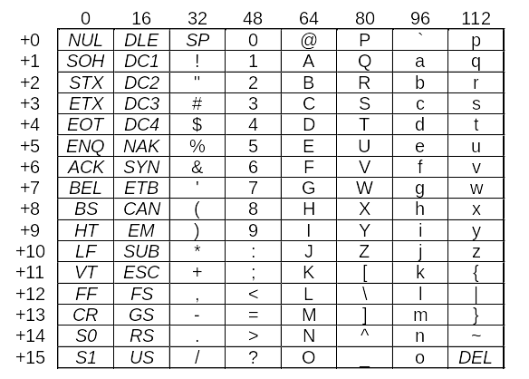
Character representation
ASCII table (7 bits)
The ASCII code of “z” is
112 + 10 = 122

Slide 70
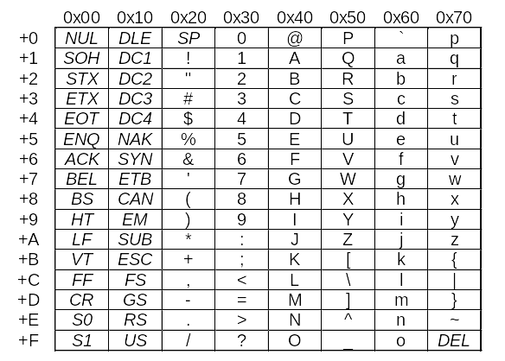
Character representation
ASCII table (7 bits)
The ASCII code of “z” is
0x70+ A = 0x7A

Slide 71
Subject 6. Data Representation

